Slide 1
Optimization Problems
. To optimize something means to maximize or minimize some aspect of it.
What are the dimensions of a rectangle with fixed perimeter having maximum area?
What is the least expensive shape for a cylindrical can?
What is the size of the most profitable production run?
The differential calculus is a powerful tool for solving problems that call for maximizing or minimizing a function.
In this part we solve a variety of optimization problems from business, mathematics, physics, and economics.

Slide 2
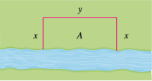
1- A farmer has 2400 ft of fencing and wants to fence off a rectangular field that borders a straight river. He needs no fence along the river. What are the dimensions of the field has the largest area?
Solution:
(for critical points to find maximum value)

Slide 3
2- Find two positive numbers whose sum is 300 and whose product is a maximum.
Solution:
(for critical points to find maximum value)

Slide 4
3- Find two positive numbers whose product is 750 and for which the sum of one and 10 times the other is maximum.
Solution:
(for critical points to find maximum)
(because question says positive numbers)

Slide 5
4- Let x and y be two positive numbers such that x+2y=50 and (x+1)(y+2) is maximum.
Solution:
(for critical points to find maximum value)

Slide 6
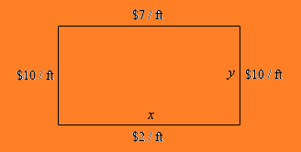
5- We are going to fence in a rectangular field. If we look at the field from above the cost of the vertical sides are $10/ft. The cost of the bottom is $2/ft and the cost of the top is $7/ft. If we have $700 determine the dimensions of the field that will maximize the enclosed area.
Solution:
(for critical points to find maximum value)

Slide 7
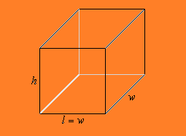
6- We have 45 metersquare of metarial to build a box with a square base and no top. Determine the dimensions of the box that will maximize the enclosed volume.
Solution:
(for critical points to find maximum value)
(length can not be negative)

Slide 8
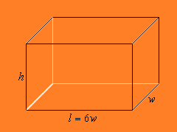
7- We want to build a box whose base length is 6 times the base with and the box will enclose 20 inchsquare the cost of material of the sides is $2/inchsquare and the cost of the top and bottom is $15/inchsquare. Determine the dimensions of the box that will minimize the cost.
Solution:
(for critical points to find minimum value)

Slide 9
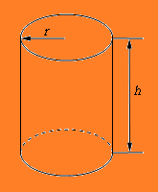
8- We want to construct a cylindirical can with a bottom but no top that will have a volume of 30 cantimetercube. Determine the dimensions of the can that will minimize the amount of metarial needed to construct the can.
Solution:
(for critical points to find minimum value)
(because length can not be 0)

Slide 10
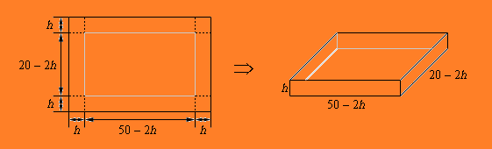
9- We have a piece of cardboard that is 50 cm by 20 cm and we are going to cut out the corners and fold up the sides to form a box. Determine the height of the box that will give maximum volume.
Solution:
(for critical points to find maximum value)

Slide 11
10- A store has been selling 200 Blu-ray disc players a week at $350 each. A market survey indicates that for each $10 rebate offered to buyers, the number of units sold will increase by 20 a week. Find the demand function and the revenue function. How large a rebate should the store offer to maximize its revenue?
Solution:
x → players sold per week
(x-200) → extra sold
(for critical points to find maximum value)
The rebate is

Slide 12
11- Suppose that and ,where x represents thousands of units. Is there a production level that maximizes profit? If so, what is it?
Solution:
(to check if there is defined points)

Slide 13
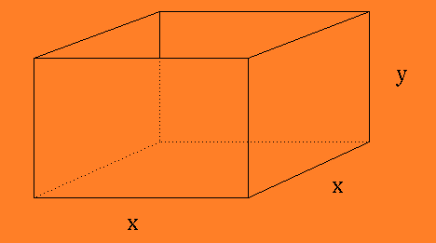
12- An open rectangular box with square base is to be made from 48 ftsquare of metarial. What dimensions will result in a box with the largest possible volume?
Solution:
(for critical points to find maximum value)
(because length can not be negative)

Slide 14
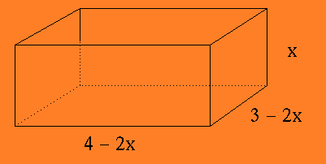
13- A sheet of cardboard 3 ft. by 4 ft. will be made into a box by cutting equal-sized squares from each corner and folding up the four edges. What will be the dimensions of the box with largest volume ?
Solution:
(for critical points to find maximum value)

Slide 15
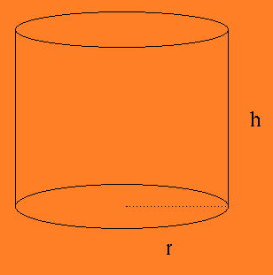
14- A container in the shape of a right circular cylinder with no top has surface are 3 pi ftsquare. What height and base radius r will maximize the volume of the cylinder?
Solution:
(for critical points to find maximum value)
(because length can not be negative)

Slide 16
15- Find two nonnegative numbers whose sum is 9 and so that the product of one number and the square of the other number is a maximum.
Solution:
(for critical points to find maximum value)

